Slide 1
Build React SPAs with the Microsoft Graph

Slide 2

Register Azure AD Applications
Microsoft Application Registration Portal
Configure credentials
Select the type of application
Configure permissions

Slide 3
Application Registration Portal (ARP)
Register applications at https://apps.dev.microsoft.com for users to login to the custom application using their Azure AD or Microsoft accounts
Create web applications, native applications (including mobile) and
Obtain application ID and secret for use in the custom code solution

Slide 4
Azure AD Portal
Azure AD Portal
https://portal.azure.com
Login using Microsoft Account (MSA) / Azure AD account (work or school)
Create Azure AD apps that use the v1 and v2 authorization endpoint
Use Azure AD’s ADAL or MSAL SDK for authentication

Slide 5
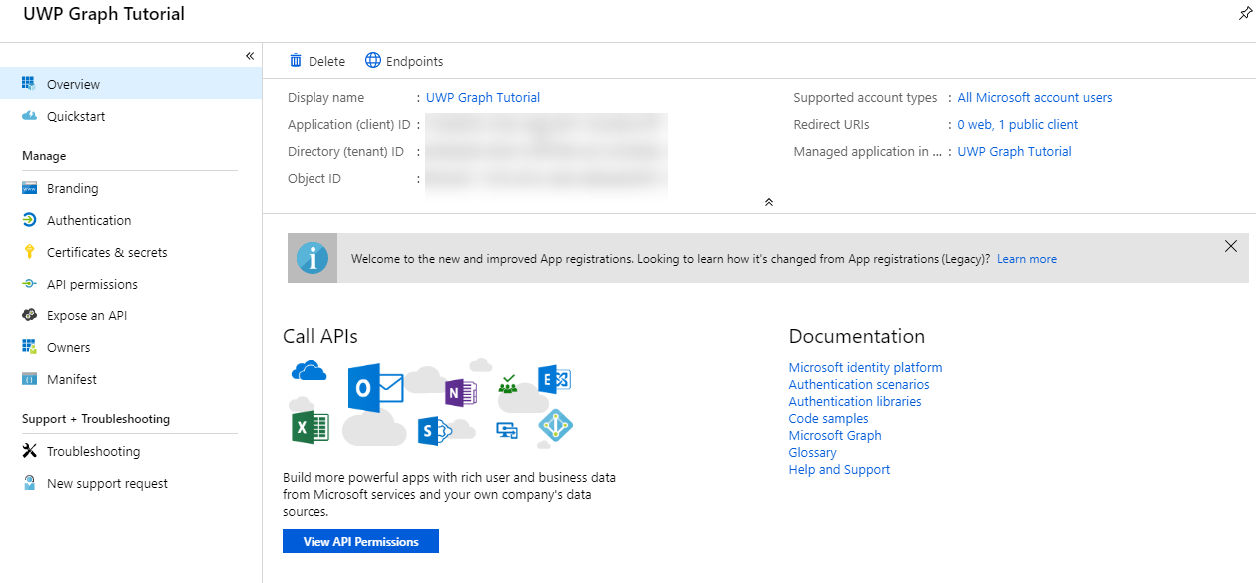
App Registration
Create the application
Copy the application’s ID
Add redirect uri to the app
Notes:
For Microsoft Graph apps, it’s recommended to use the Azure AD v2 authorization endpoint
Create the application
Copy the Application ID
Add a new Native application and add the necessary permissions

Slide 6
Demo

Slide 7
Thank you.

